Slide 1

School Boards Preservice
An information program for potential new members of an existing School Board

Slide 2
Five areas of preservice
understanding the shared wisdom model
spirituality
responsibilities of the Board
Board membership
relationships

Slide 3
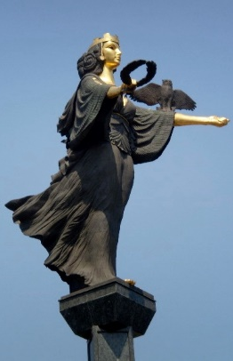
Sharing wisdom
The shared wisdom model
To each the Lord gives a piece of the wisdom
To no one does God give all the wisdom
We all get different pieces
Mary Benet McKinney, OSB
For our Board this means:
we bring our personal gifts to share
we respectfully listen to others
we enter openly into discussions
there is no lobbying, bullying or struggle for power

Slide 4

Sharing wisdom
The shared wisdom model
Be willing to let go…be able to surrender to the voice of the Spirit when it is heard
Mary Benet McKinney, OSB
For our Board this means:
have your own ideas and share them
be open to new ideas
be prepared to let your opinions change
be willing to listen to the spirit in others
have no ‘barrows to push’

Slide 5

Sharing wisdom
The shared wisdom model
A sincere desire to listen to the call to holiness through our gifts…
Mary Benet McKinney, OSB
For our Board this means:
membership for service not power
we all have gifts and talents to offer
prayer and reflection are important
a willingness to minister to the community
willing acceptance of personal spiritual development and training

Slide 6

Sharing wisdom
The shared wisdom model
Agreement amongst members either to work until consensus is reached or agree with majority decision…
Mary Benet McKinney, OSB
For our Board this means:
no decision is agreed to unless members support it
no win or lose
decisions will take time
research, consultation and reflection will be required

Slide 7

Practical implications of the shared wisdom model
gather data
reflect prayerfully on the data
share the wisdom that results from reflection

Slide 8

Spirituality
A call to develop one’s relationship with God through prayer and reflection on where and how God is in our lives…

Slide 9

Responsibilities
Preservice and inservice
Preservice is to ensure people understand the nature of School Boards before they become involved
Inservice ensures Board members remain aware of the implications of the Constitution on Board activities

Slide 10

Responsibilities
Develop a mission statement
sets direction for the school
policies are based on the mission statement
based on Gospel values
developed in consultation with school community
needs to be reviewed regularly

Slide 11

Responsibilities
Develop policies
state what to do but not how to do it
evolve from the values contained in the mission statement
unify and align the school community
develop from needs
require extensive consultation
reviewed periodically

Slide 12

Responsibilities
Constitution and by-laws
the constitution is the legal document that guides the Board
interpreted pastorally
by-laws are prepared by Boards for specific local purposes and are approved by the Executive Director Catholic Schools

Slide 13
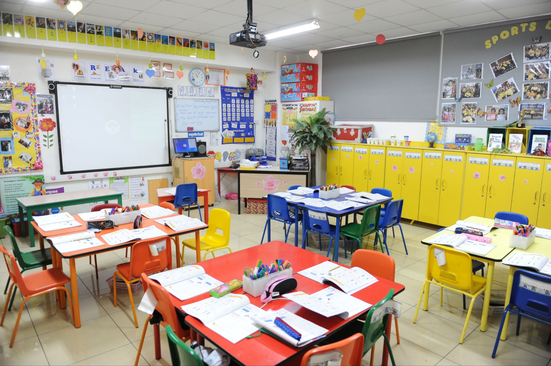
Responsibilities
Provision and maintenance of school/college buildings and plant
develop strategic plan
prepare funding applications
could be a sub-committee
may co-opt suitable person
Staffing
Board’s responsibility is advisory only
Principal raises matters with regards to staffing to seek advice
Budgeting
Actions at the discretion of the Principal
Specific actions dependent on parish, school and TCS expectations

Slide 14

Responsibilities
Curriculum
Principal is the curriculum leader on the Board
issues discussed are of a general nature
Communications
regular and clear communication with other key groups
seek regular feedback
community need to know who is on the Board and what the Board is doing

Slide 15
Board membership
Ex-officio
pastoral/spiritual Leader
Principal
members of any Religious Order if the Principal is lay
Elected
one teacher member (elected by staff)
three parent members (elected by the Parent Body)
one Member (elected by the Parish Council)
(if no Parish Council, local by-laws may state that four parent members are elected)
Co-opted
maximum of two
If any accountant/financial advisor has not been elected to the Board, then a person with the necessary skills should be one of the co-opted members
One member of the Board should be a member of the Parents and Friends Association and act as a liaison between the two bodies

Slide 16
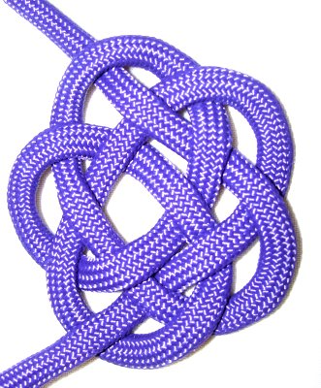
Board membership
Reminders
members do not represent any groups
Board members minister to the needs of all
members prepare, listen, discuss, reflect, discern and then decide
there are no legal implications around being a Board member
Board members need a blue card if they are not parents of the school community

Slide 17
Relationships
Principal
As leader:
prepares the agenda with the Chairperson
prepare reports
leads policy development
As servant:
implements policy and actions
Pastoral/Spiritual leader
offers spiritual insights
provides data from the Parish
gives guidance with respect to Church expectations
oversees the Board’s commitment to prayer and reflection

Slide 18

Relationships
Elected and co-opted members
freely and full participate
are all equal
honour and abide by board decisions
are guided by loyalty and integrity
observe confidentiality

Slide 19
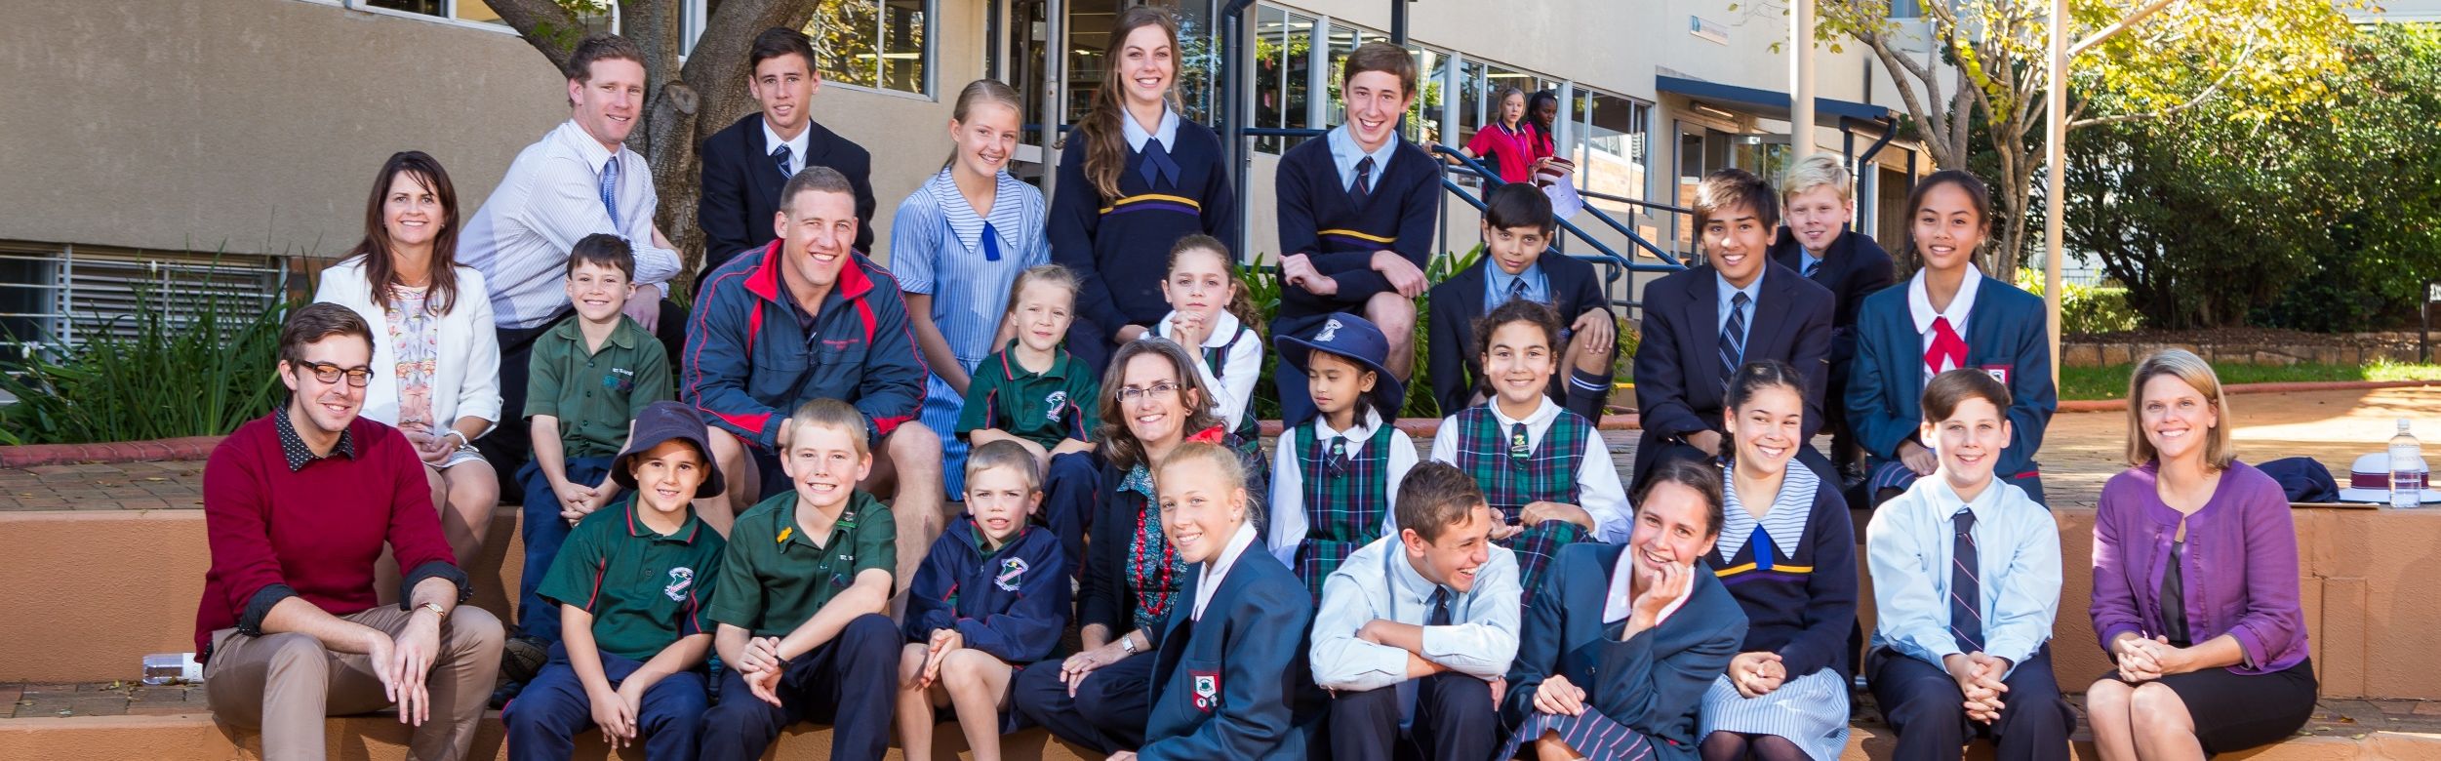
For further information…
contact your local Catholic School Principal
visit the Diocese of Toowoomba Catholic Schools website www.twb.catholic.edu.au

